Slide 1
A Comparison of Progressive Item Selection Procedures for Computerized Adaptive Tests
Brian Bontempo, Mountain Measurement
Gage Kingsbury, NWEA
Anthony Zara, Pearson VUE

Slide 2
Soap Box
Problems with Item Exposure Control Mechanism research to date
Focus has been on the frequency of exposure not the duration of time in the field, fresh items vs. stale items
Not enough empirical research linking exposure to parameter drift
Focus has been on OVER exposure and not enough on under exposure (of high quality items)
Referred to Item Exposure Control Mechanisms rather than Item Selection Algorithms

Slide 3
Issues with Maximum Information CAT
Item Overexposure & Underexposure
Sparse Data Matrix
Narrow ability distribution around each operational item
P-Values approach target probability
Item-Total Point Biserial-Correlation Coefficients have restriction of range issues
DIF - no examinees around true difficulty so estimation is off
Parameter drift – no examinees around true difficulty so estimation is off
Item Overlap between adjacent tests

Slide 4
Item Selection Algorithms
Kingsbury, G.G. & Zara, A.R. (1991)
The Ψ items (“pond”) with the most information are selected. From there, a single item is selection at random.
Revuelta, J. & Ponsada, V. (1998)
Items are selected completely at random at the beginning of the test and selected entirely based on maximum information at the end w=(1-s)R_{i}+sI.

Slide 5
Item Selection Algorithms
Kingsbury, G.G. & Zara, A.R. (1991)
Succeeded in reducing exposure and overlap
Did not widen the variance of the ability of candidates taking each item
Revuelta, J. & Ponsada, V. (1998)
Succeeded in reducing exposure
Succeeded in widening the variance of the ability of candidates taking each item
Major problems with overlap between adjacent tests

Slide 6
Hybrid Randomesque Progressive Item Selections Algorithms
Improve pool utilization
Improve the usefulness of p-value, pt-bis, DIF, and drift
Reduce overlap

Slide 7
Hybrid Randomesque Progressive Item Selections Algorithms
Progressive Random to Targeted using Information
Select one item at random from the Ψ items with the greatest weights (w)
w = (1-s)R_{i}+sI
s = Serial position (sequence number)/test length
R = Random component
I = Test Information

Slide 8
Hybrid Randomesque Progressive Item Selections Algorithms
Progressive Random to Targeted with a fixed probability of correct response
Select one item at random from the Ψ items with the greatest weights (w)
w = (1-s)/R_{i}+s/|P_{ij}– P_{target}|
s = Serial position (sequence number)/test length
R = Random component
P_{ij} = Probability of Correct Response

Slide 9
Hybrid Randomesque Progressive Item Selections Algorithms
Progressive Random to Targeted with a linear shrinking pond size
Select one item at random from the Ψ items that are best targeted or yield the highest information
_{ij}=N_{pool}-s(N_{pool} /N_{test})+c
s = Serial position (sequence number)/test length
N_{pool} = Number of Items in Item Pool
N_{test} = Number of Items in the Test
c = constant

Slide 10
Hybrid Randomesque Progressive Item Selections Algorithms
Progressive Random to Targeted using SEM
Select one item at random from the Ψ items that are within the probability derived from the confidence interval around the ability estimate
P_{i}(θ_{low}) < P_{i} (θ) < P_{i}(θ_{high})
P_{i}(θ_{low}) = Calculate the item parameters for a perfectly targeted item using the ability estimate at the low end of the confidence interval. Then calculate the probability of correct response to this item using the ability estimate
P_{i}(θ_{high}) = Calculate the item parameters for a perfectly targeted item using the ability estimate at the high end of the confidence interval. Then calculate the probability of correct response to this item using the ability estimate

Slide 11
Simulation Study

Slide 12
Algorithms Tested
Maximum information
Kingsbury & Zara
Progressive
Progressive Random to Targeted using Information (Ψ =10)
Progressive Random to Targeted with a fixed probability of correct response (Ψ =10)
Progressive Random to Targeted with varying pond size (c=length of test/item pool size)
Progressive Random to Targeted using SEM (1.36)

Slide 13
Simulation Design
Item pool - 1,000 actual item parameter estimates (1 PL/Rasch)
Test design - 3 different fixed test lengths
25 items
50 items
100 items
Test takers – A sample of 10,000 test takers was drawn randomly from the initial sample of test takers. For each sim, the ability estimate from the actual test was input as the true trait level.
21 sims per test taker (3 test lengths X 7 item selection algorithms)

Slide 14
Evaluation Criteria
Impact on test precision
Impact on the variance in the ability distribution for each item
Impact on item exposure and usage

Slide 15
Results

Slide 16
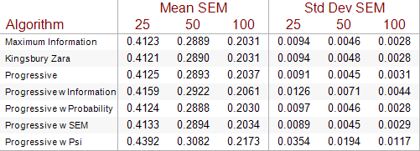
Precision

Slide 17
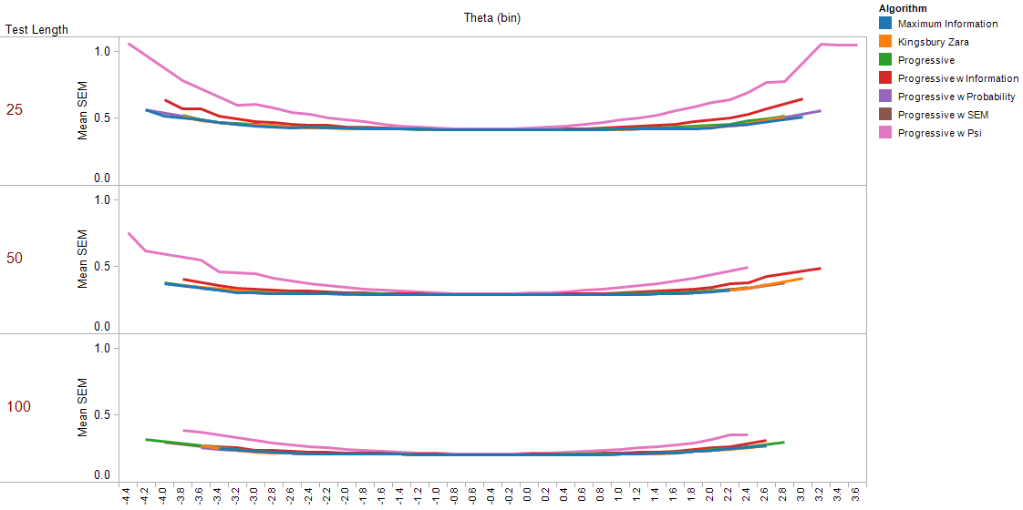
Precision

Slide 18
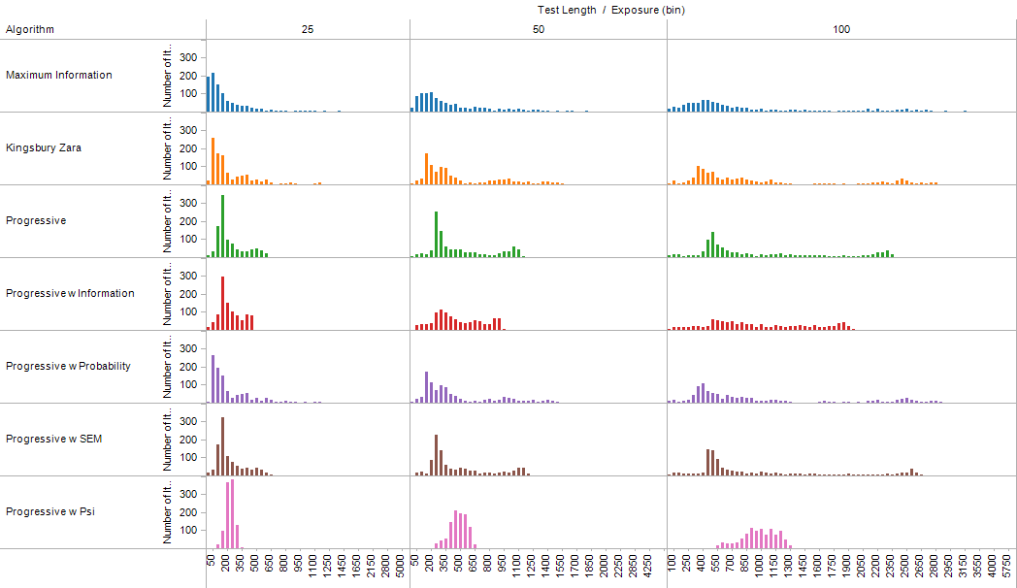
Exposure

Slide 19
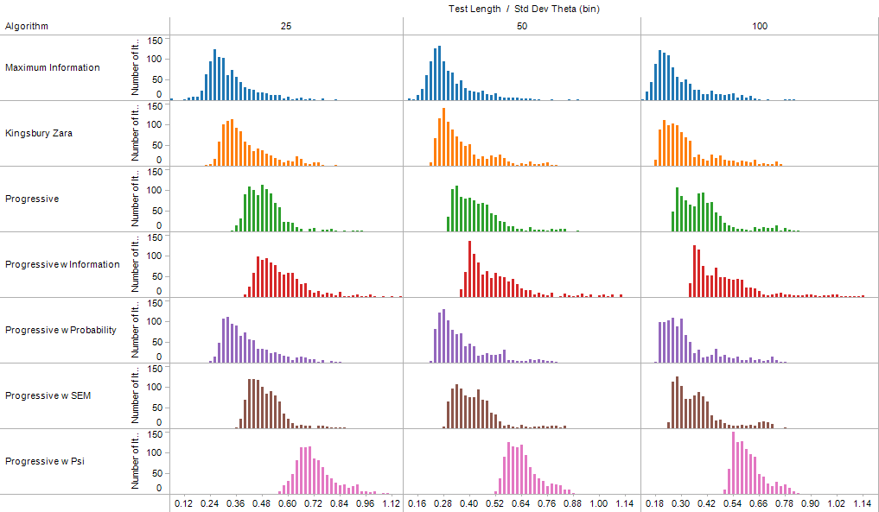
Variance in Ability Estimate

Slide 20
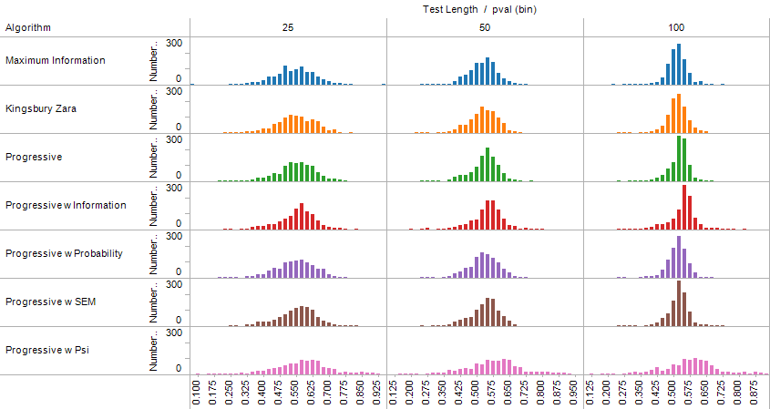
P-Value

Slide 21
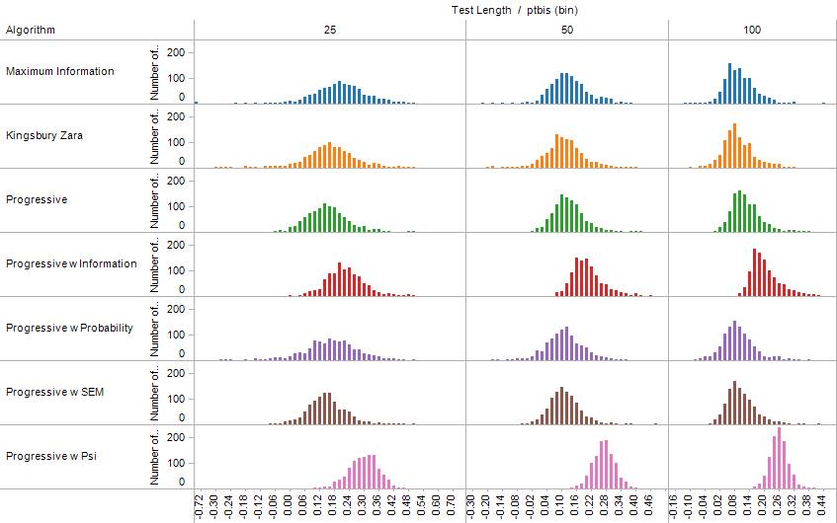
Item-Total Point-Biserial

Slide 22
Summary
Quality CAT design should focus on effective Item Selection Algorithms not Item Exposure Control Mechanisms
We can evaluate Item Selection Algorithms based on efficiency, pool utilization, and the distribution of the variance in the ability estimates around the items.
Four Hybrid Progressive Randomesque item selection algorithms were defined.
The Progressive Random to Targeted using Test Information proved successful.

Slide 23
Future Research
The algorithms need to be tweaked.
The algorithms need to be tested on longer tests.
The overlap between adjacent tests needs to be assessed.
The study needs to include an items select at random algorithm as a benchmark.

Slide 24
Thank You for Listening!
For a copy of the paper contact:
Brian Bontempo, Ph.D.
brian@mountainmeasurement.com

